Slide 1
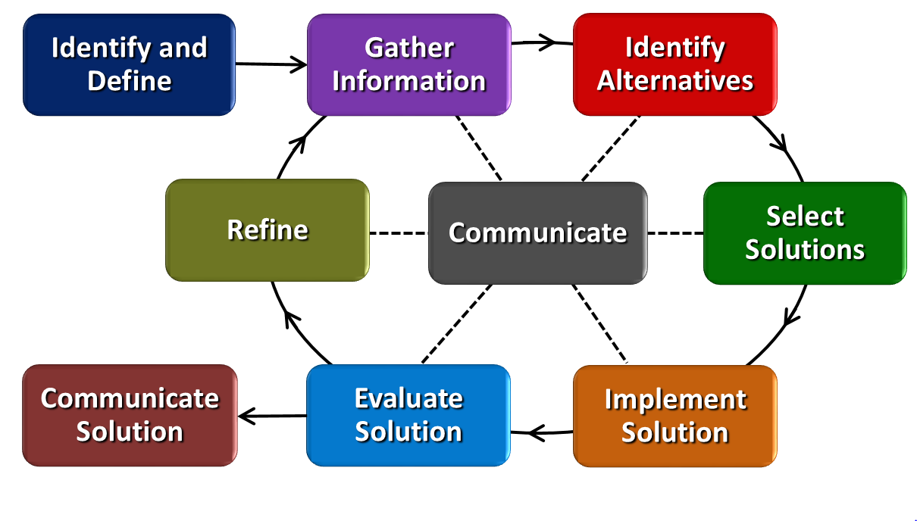
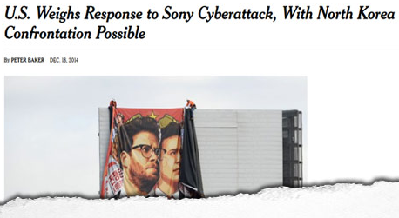
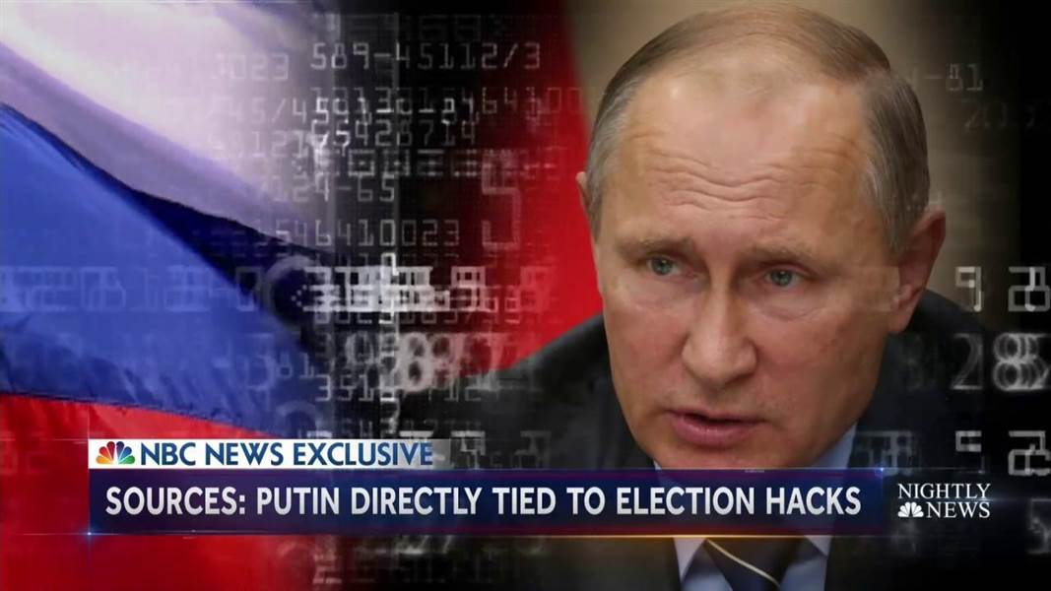
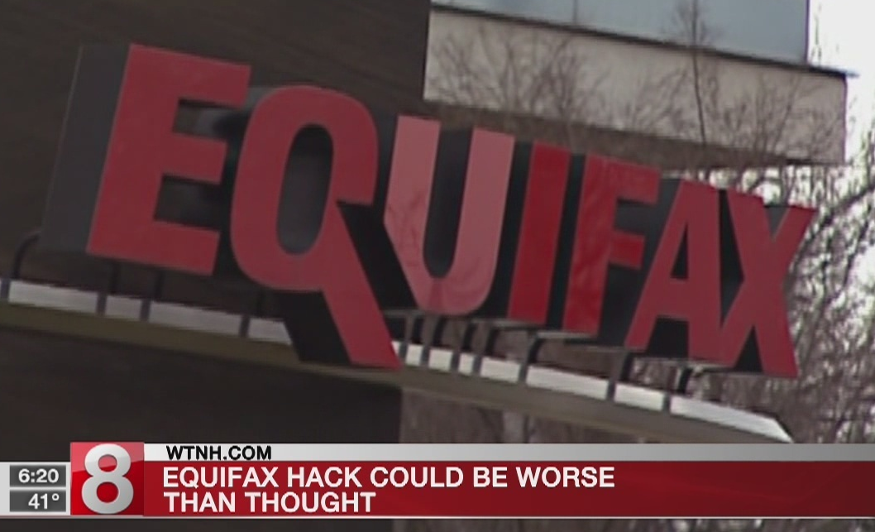
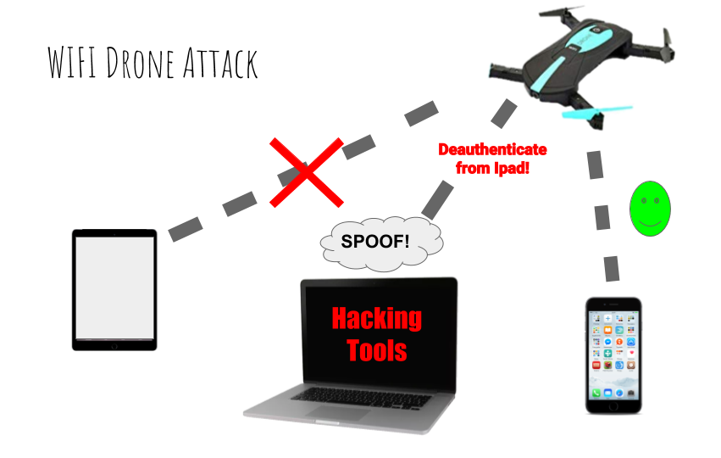
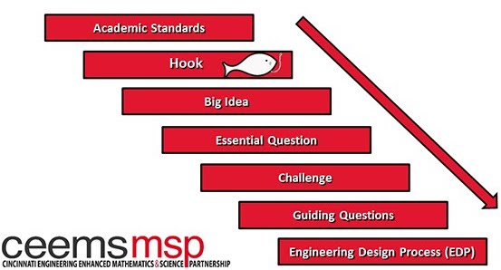
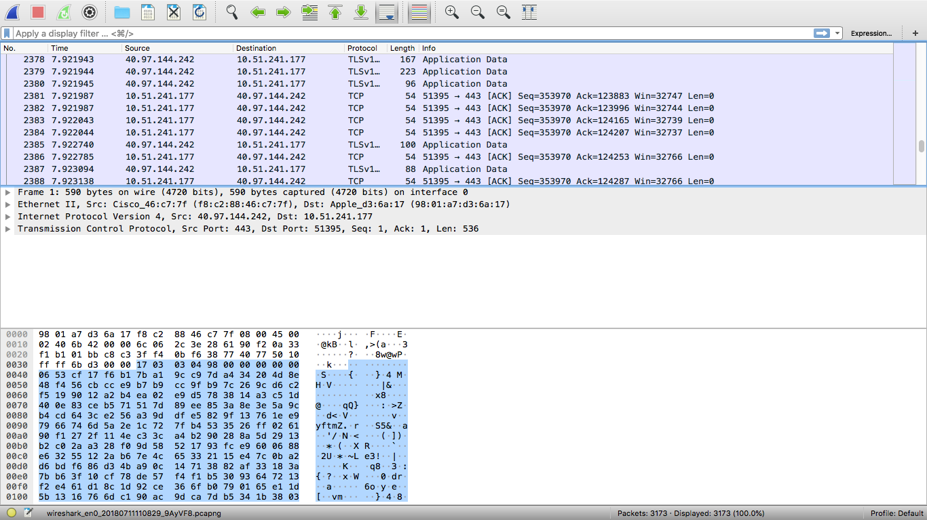
Network Traffic and Cybersecurity
Adam Mesewicz
Holmes High School | AP Statistics | 2018-2019
RET is funded by the National Science Foundation, grant # EEC-1710826
Summer Research
Engineering in the Classroom
What’s the Big Idea?
Ethical Hacking
Engineering Design Process
Detecting Cyber Attacks
Vulnerabilities
Penetration Testing
White Hat vs. Black Hat
How do we detect and defend against Cyber Attacks?
Can probability and statistics help with detection?
Challenge Based Learning
Intrusion Detection
DDoS Attack
Man in the Middle
Packet Scanning

